Slide 1
Network programming
Department of informatics
Institut teknologi sepuluh nopember

Slide 2
outline
Simple Mail Transfer Protocol
SMTP Python Example
Sample SMTP Interactions
Gmail API

Slide 3
Electronic mail (email)
Three major components:
user agents
mail servers
simple mail transfer protocol: SMTP
User Agent
a.k.a. “mail reader”
composing, editing, reading mail messages
e.g., Outlook, Thunderbird, iPhone mail client
outgoing, incoming messages stored on server

Slide 4
Mail servers
Mailbox contains incoming messages for user
Message queue of outgoing (to be sent) mail messages
SMTP protocol between mail servers to send email messages
client: sending mail server
“server”: receiving mail server

Slide 5
SMTP [RFC 2821]
uses TCP to reliably transfer email message from client to server, port 25
direct transfer: sending server to receiving server
three phases of transfer
handshaking (greeting)
transfer of messages
closure
command/response interaction (like HTTP, FTP)
commands: ASCII text
response: status code and phrase
messages must be in 7-bit ASCII

Slide 6
Smtp RFC
RFC 2821 (2001)
https://www.rfc-editor.org/rfc/rfc2821
Obsoleted by RFC 5321 (2008)
https://www.rfc-editor.org/rfc/rfc5321

Slide 7
E-mail Clients vs. Webmail Services
The first generation of e-mail users were given usernames and passwords by their business or university, which provided them with command-line access to the large mainframes (local network).
The next generation of users to begin using the Internet was often not familiar with the idea of a command line.
The use of the graphical interface is more popular
Development of mail access protocol: POP (Post Office Protocol) and IMAP (Internet Message Access Protocol)

Slide 8
SMTP
SMTP is a TCP/IP-based protocol.
Connections can be authenticated or not.
Connections can be encrypted or not.

Slide 9
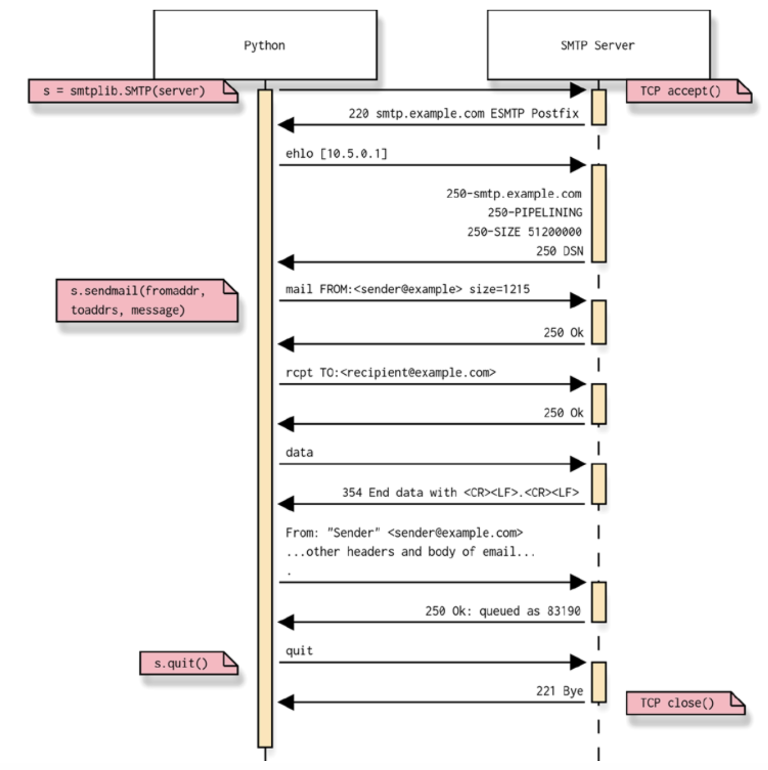
Python smtp session

Slide 10
Python smtplib Example
import smtplib
def prompt(prompt):
return input(prompt).strip()
fromaddr = prompt("From: ")
toaddrs = prompt("To: ").split()
print("Enter message, end with ^D (Unix) or ^Z (Windows):")
# Add the From: and To: headers at the start
msg = ("From: %s\r\nTo: %s\r\n\r\n"
% (fromaddr, ", ".join(toaddrs)))
while True:
try:
line = input()
except EOFError:
break
if not line:
break
msg = msg + line
Send the message using smtplib
print("Message length is", len(msg))
server = smtplib.SMTP('smtp.office365.com', 587)
server.set_debuglevel(1)
server.starttls()
server.login('hudan@its.ac.id', 'xxx')
server.sendmail(fromaddr, toaddrs, msg)
server.quit()
Prepare the message

Slide 11
Sample SMTP interaction
From: hudan@its.ac.id
To: studiawan@gmail.com
Message: hello this is an email for the network programming course

Slide 12
send: 'ehlo 192.168.1.2\r\n'
reply: b'250-SI1PR02CA0017.outlook.office365.com Hello [2001:448a:50e1:63a5:c008:83d6:fdbb:60b4]\r\n'
reply: b'250-SIZE 157286400\r\n'
reply: b'250-PIPELINING\r\n'
reply: b'250-DSN\r\n'
reply: b'250-ENHANCEDSTATUSCODES\r\n'
reply: b'250-STARTTLS\r\n'
reply: b'250-8BITMIME\r\n'
reply: b'250-BINARYMIME\r\n'
reply: b'250-CHUNKING\r\n'
reply: b'250 SMTPUTF8\r\n'
reply: retcode (250); Msg: b'SI1PR02CA0017.outlook.office365.com Hello [2001:448a:50e1:63a5:c008:83d6:fdbb:60b4]\n
SIZE 157286400\nPIPELINING\nDSN\nENHANCEDSTATUSCODES\nSTARTTLS\n8BITMIME\nBINARYMIME
\nCHUNKING\nSMTPUTF8'

Slide 13
send: 'STARTTLS\r\n'
reply: b'220 2.0.0 SMTP server ready\r\n'
reply: retcode (220); Msg: b'2.0.0 SMTP server ready'
send: 'ehlo 192.168.1.2\r\n'
reply: b'250-SI1PR02CA0017.outlook.office365.com Hello [2001:448a:50e1:63a5:c008:83d6:fdbb:60b4]\r\n'
reply: b'250-SIZE 157286400\r\n'
reply: b'250-PIPELINING\r\n'
reply: b'250-DSN\r\n'
reply: b'250-ENHANCEDSTATUSCODES\r\n'
reply: b'250-AUTH LOGIN XOAUTH2\r\n'
reply: b'250-8BITMIME\r\n'
reply: b'250-BINARYMIME\r\n'
reply: b'250-CHUNKING\r\n'
reply: b'250 SMTPUTF8\r\n'
reply: retcode (250); Msg: b'SI1PR02CA0017.outlook.office365.com Hello [2001:448a:50e1:63a5:c008:83d6:fdbb:60b4]\n
SIZE 157286400\nPIPELINING\nDSN\nENHANCEDSTATUSCODES\nAUTH LOGIN XOAUTH2\n
8BITMIME\nBINARYMIME\nCHUNKING\nSMTPUTF8'

Slide 14
send: 'AUTH LOGIN xxx\r\n'
reply: b'334 xxx\r\n'
reply: retcode (334); Msg: b’xxx'
send: ‘xxx\r\n'
reply: b'235 2.7.0 Authentication successful\r\n'
reply: retcode (235); Msg: b'2.7.0 Authentication successful'
send: 'mail FROM:<hudan@its.ac.id> size=109\r\n'
reply: b'250 2.1.0 Sender OK\r\n'
reply: retcode (250); Msg: b'2.1.0 Sender OK'
send: 'rcpt TO:<studiawan@gmail.com>\r\n'
reply: b'250 2.1.5 Recipient OK\r\n'
reply: retcode (250); Msg: b'2.1.5 Recipient OK'

Slide 15
send: 'data\r\n'
reply: b'354 Start mail input; end with <CRLF>.<CRLF>\r\n'
reply: retcode (354); Msg: b'Start mail input; end with <CRLF>.<CRLF>'
data: (354, b'Start mail input; end with <CRLF>.<CRLF>')
send: b'From: hudan@its.ac.id\r\nTo: studiawan@gmail.com\r\n\r\nhello this is an email for the
network programming course\r\n.\r\n'
reply: b'250 2.0.0 OK <PU1PR04MB2453354E55C5C52A94DA0071ED949@PU1PR04MB2453.apcprd04.prod.outlook.com>
[Hostname=PU1PR04MB2453.apcprd04.prod.outlook.com]\r\n'
reply: retcode (250); Msg: b'2.0.0 OK <PU1PR04MB2453354E55C5C52A94DA0071ED949@PU1PR04MB2453.apcprd04.
prod.outlook.com> [Hostname=PU1PR04MB2453.apcprd04.prod.outlook.com]'
data: (250, b'2.0.0 OK <PU1PR04MB2453354E55C5C52A94DA0071ED949@PU1PR04MB2453.apcprd04.prod.outlook.com>
[Hostname=PU1PR04MB2453.apcprd04.prod.outlook.com]')
send: 'quit\r\n'
reply: b'221 2.0.0 Service closing transmission channel\r\n'
reply: retcode (221); Msg: b'2.0.0 Service closing transmission channel'

Slide 16
Smtp command reference
EHLO (Extended Hello)
AUTH (Authentication)
STARTTLS (Start Transport Layer Security)
SIZE
HELP, etc.
Reference: https://www.samlogic.net/articles/smtp-commands-reference.htm
In the beginning, it was command line

Slide 17
Python library
SMTP: smtplib
https://docs.python.org/3/library/smtplib.html
IMAP: imaplib
https://docs.python.org/3/library/imaplib.html
POP3: poplib
https://docs.python.org/3/library/poplib.html

Slide 18
Python examples
https://github.com/studiawan/network-programming/tree/master/bab10
https://github.com/brandon-rhodes/fopnp/tree/m/py3/chapter13

Slide 19
Mail message format
RFC 822: standard for text message format:
header lines, e.g.,
To:
From:
Subject:
different from SMTP MAIL FROM, RCPT TO: commands!
Body: the “message”
ASCII characters only
RFC 822 (1982) → RFC 2822 (2001) → RFC 5322 (2008)
At the moment, mail message can support utf-8 encoding or HTML format

Slide 20

Gmail api
The Gmail API is a RESTful API that can be used to access Gmail mailboxes and send mail. For most web applications the Gmail API is the best choice for authorized access to a user's Gmail data and is suitable for various applications, such as:
Read-only mail extraction, indexing, and backup
Automated or programmatic message sending
Email account migration
Email organization including filtering and sorting of messages
https://developers.google.com/gmail/api/guides

Slide 21
Gmail api with python
Enable the API
Authorize credentials for a desktop application
Install the Google client library
Run the Python API client
https://developers.google.com/gmail/api/quickstart/python

Slide 22
Gmail imap, POP, smtp
For non-Gmail clients, Gmail supports the standard IMAP, POP, and SMTP protocols. The Gmail IMAP, POP, and SMTP servers have been extended to support authorization via the industry-standard OAuth 2.0 protocol.
https://developers.google.com/gmail/imap/imap-smtp
https://github.com/google/gmail-oauth2-tools/wiki/OAuth2DotPyRunThrough

